Slide 1
Programme 3
Mickey Ma (马毓琦): mickeyma@cuhk.edu.cn
Office: Teaching C Building Room 501(TC-501)
Phone: 0755-23519635
WeChat: my_qiqi
Office Hours: TUE 16:00-17:00
FRI 16:00-17:00

Slide 2

Block Diagram
opcode
operation code
Testbench
input a
reg_A
output c
reg_C
reg_B
input b
flags
flag registers

Slide 3
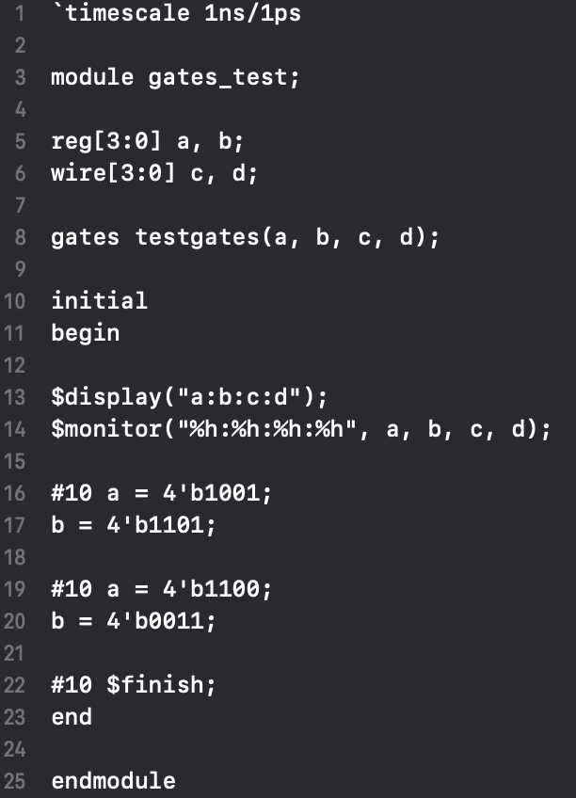

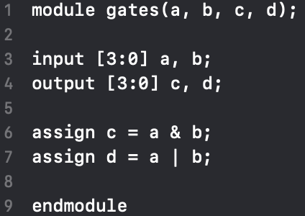
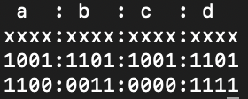
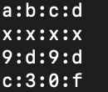
A Simple
Verilog Example
Test bench
Verilog module
Results
hexadecimal binary
https://www.doulos.com/knowhow/verilog_designers_guide/

Slide 4
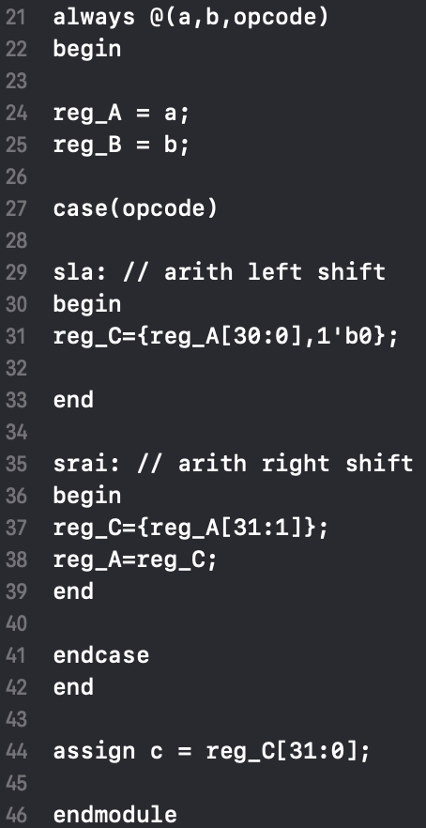
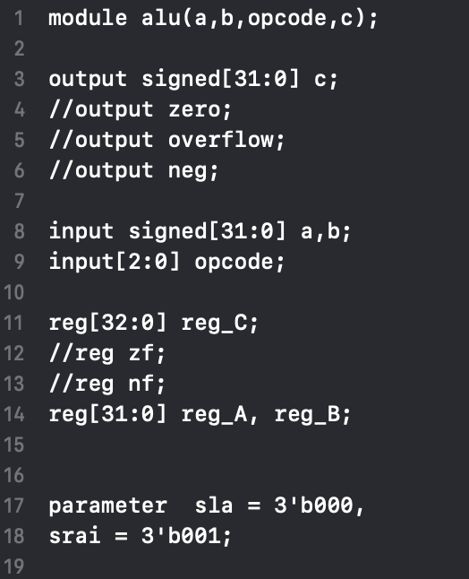
ALU.v

Slide 5
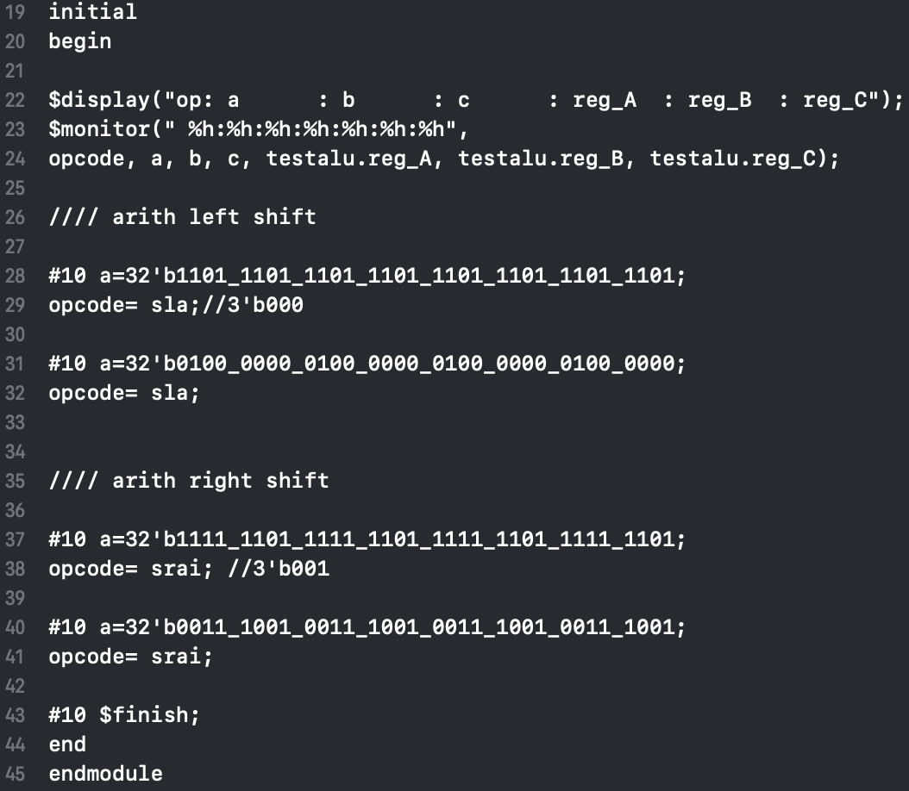
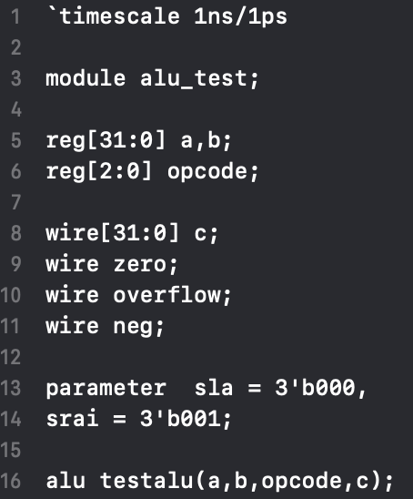
test_ALU.v

Slide 6
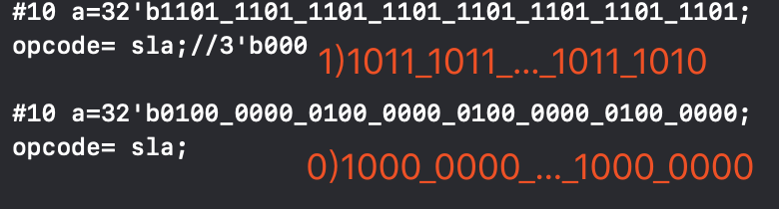
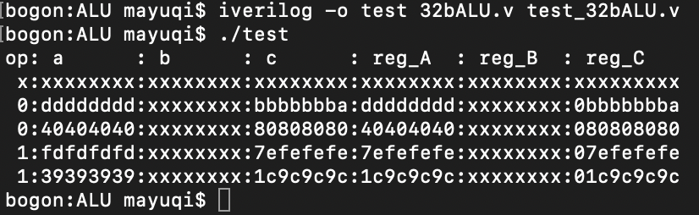
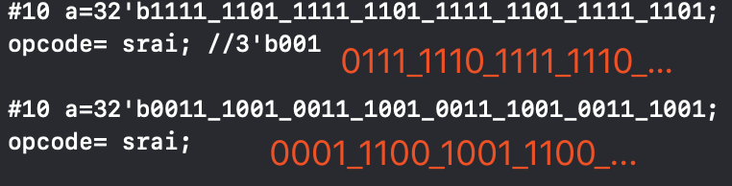
Icarus Verilog
http://iverilog.icarus.com/
Mac: https://blog.csdn.net/zach_z/article/details/78787509
Win: http://bleyer.org/icarus/

Slide 7
Grading
Support the Arithmetic/Logic operations - 60%
The ALU must support:
add, sub, mult, div
addi
addu, subu, multu, divu
addiu
sqrt
and, or, nor, xor, xnor
andi, ori
slt, slti
With special handling for flags - 30%
Sign extend - 10%
Zero extend - 10%
Overflow detection - 10%
Project report - 10%

Slide 8
Multiplication
n bit A, B
C = 0;
for (i = 0; i < n; i++)
if (B[i])
C = C + A<<(i);
Example:
A = 00001001, B = 00000110;
i = 0：B0 = 0；
i = 1：B1 = 1； C = C + 00010010 = 00010010；
i = 2：B2 = 1； C = C + 00100100 = 00110110；
i > 2：Bi = 0；
So C = 00110110；

Slide 9
Square Root
Example:
11_{D}² = 121_{D}²
sqrt(122_{D}) = 11_{D};
sqrt(1111010_{B}) = 1011_{B}
1 11 10 10
1： 1² = 1, so the highest bit is 1
111： 11² = 1001 > 111, so the second highest bit is 0;
11110： 101² = 11001 < 11110, so the third highest bit is 1;
1111010: 1011² = 1111001 < 1111010, so the last bit is 1.

Slide 10
Overflow Detection

Slide 11
An optional way to deal with 32bit MIPS instruction in the ALU
add & addi:
Original in 16 bit: addi in 16bit cpu should do rewrite to the input register
In 32bit MIPS instruction, the difference is just the input. The input in a register is 32bit and immediate number is 16bit. So for the instruction addi, change the input to: 32bit a (for the register) and 16bit b(for the immediate number).
mult and div:
In the cpu, we can just store 32bit result so for the multiplication of two 32bit number, the result may be overflow. Another solving method is to use two more registers(Lo, Hi) to store the output.

Slide 12
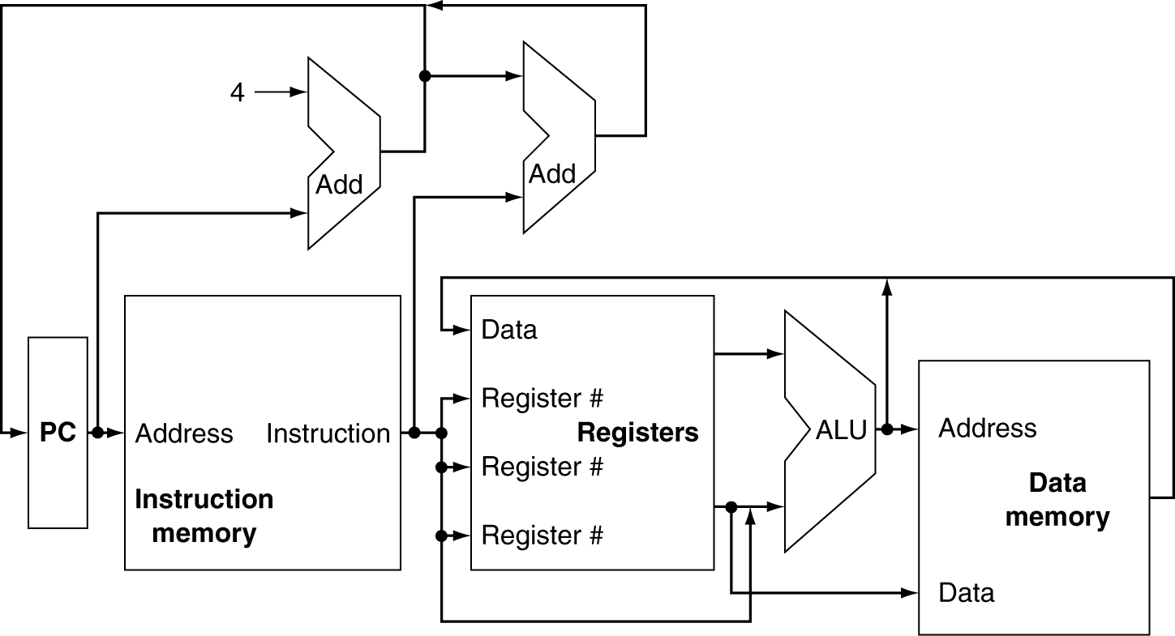
Datapath

Slide 13
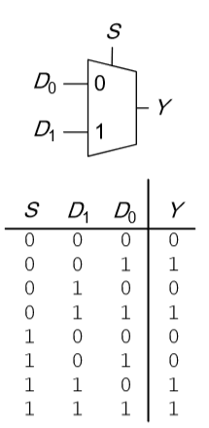
Datapath
Multiplexers

Slide 14
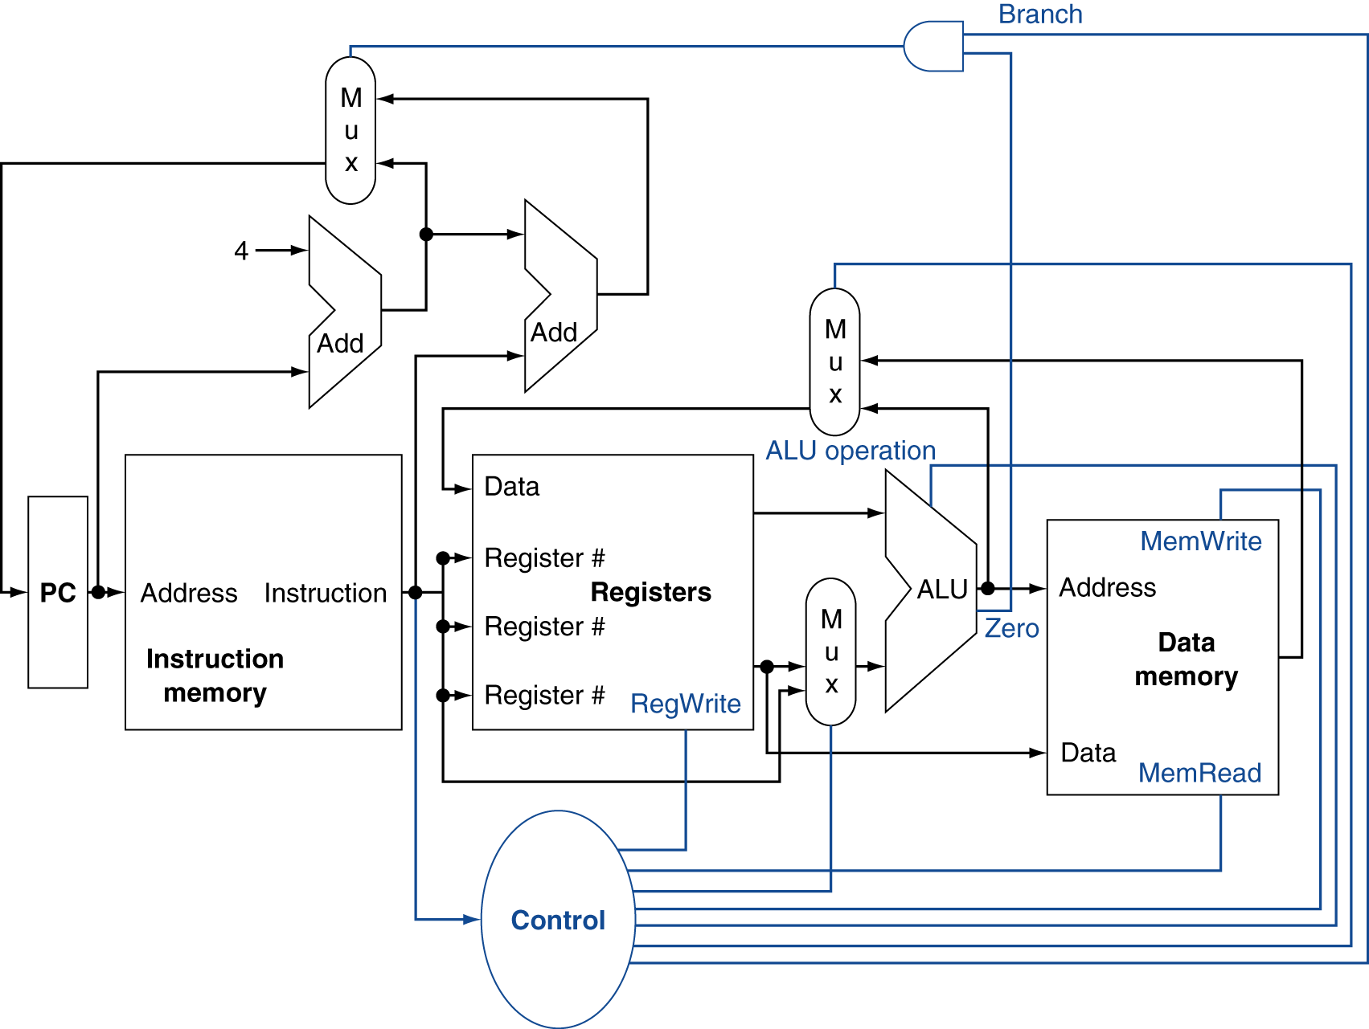
Datapath

Slide 15
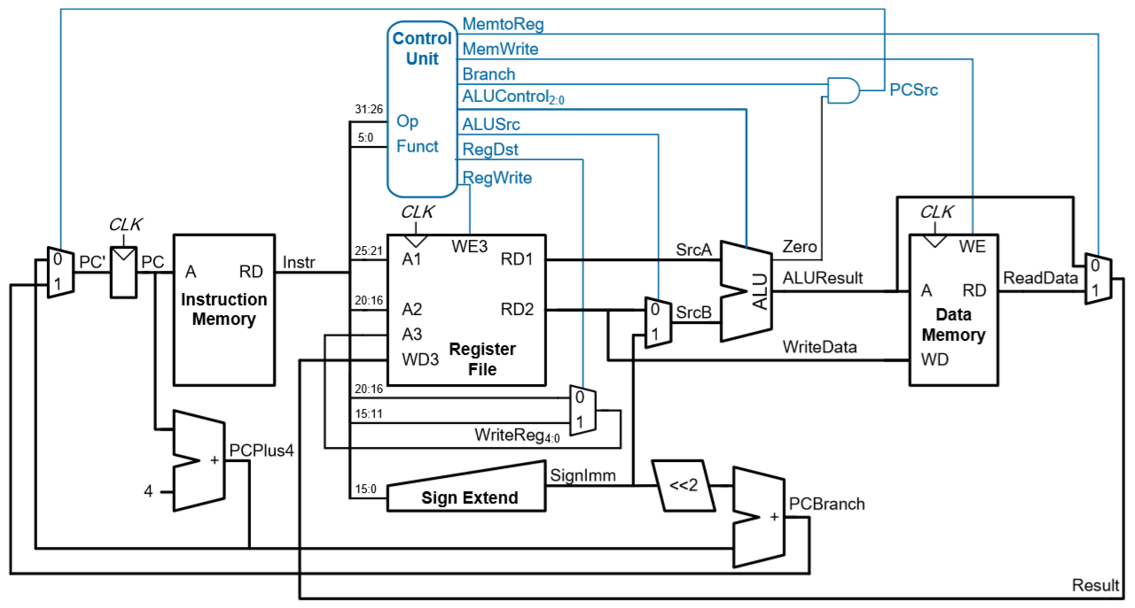
Single-cycle MIPS Processor

